Slide 1
DBMS PROJECT · REVIEW 1
DESIGN AND IMPLEMENTATION OF A DATABASE MANAGEMENT SYSTEM FOR EMPLOYEE ATTENDANCE, SHIFT AND LEAVE MANAGEMENT SYSTEM
Maydhaansh Nanda
25WU0102155

Slide 2
The Problem
The current employee management process can involve fragmented or manually maintained information for:
Employee Records
Attendance
Shift Allocation
Leave Requests
Leave Approvals
01
Fragmented Records
02
Manual Tracking
Employee-related information may exist across different records or systems.
Manual attendance and leave tracking can introduce duplication and errors.
03
Shift Coordination
04
Data Retrieval
Managing employee schedules and shift assignments becomes difficult without centralized data.
Finding historical attendance, shift and leave information can be inefficient.

Slide 3
Scope & Objectives
SCOPE
OBJECTIVES
The database covers:
01
Centralize employee-related information.
—
Employee information
—
Attendance records
02
Maintain accurate attendance records.
—
Shift assignment
03
Simplify shift assignment and tracking.
—
Leave requests
—
Leave approval / status
04
Organize leave requests and approvals.
—
Administrative records
05
Enable efficient retrieval of employee information.
EMPLOYEE ATTENDANCE, SHIFT & LEAVE MANAGEMENT SYSTEM

Slide 4
Our Solution
A centralized relational database that unifies employee information, attendance records, shift assignments, leave requests and approvals, and administrative records into a single structured system.
EMPLOYEES
CENTRAL DATABASE
ATTENDANCE
SHIFTS
LEAVE

Slide 5
System Users
Administrator
Employee
Manager / HR
Manage employee records
View attendance
Review attendance
Manage shifts
View assigned shift
Approve / reject leave
Monitor attendance
Apply for leave
Monitor employee schedules
Manage leave records
Track leave status
Access relevant reports

Slide 6
Functional Requirements
Employee Management
Attendance Management
—
Add employee
—
Record attendance
—
Update employee
—
Track attendance status
—
View employee records
—
View attendance history
Shift Management
Leave Management
—
Create / manage shifts
—
Submit leave requests
—
Assign employees to shifts
—
Approve / reject leave
—
Track schedules
—
Track leave status

Slide 7
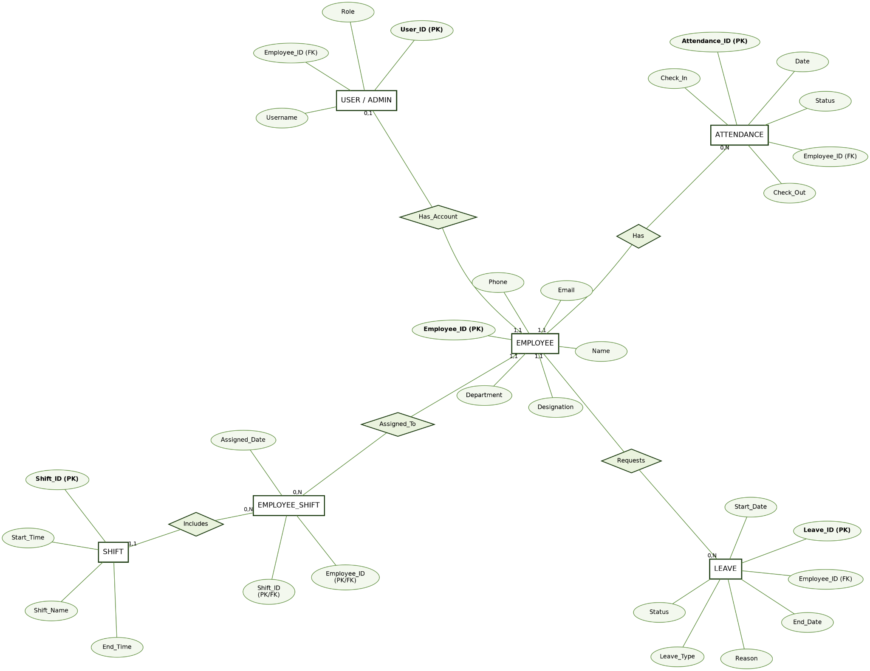
Entity Relationship Diagram

Slide 8
Relationship Notes
These relationships enforce referential integrity and mirror the real-world structure of the organization.
EMPLOYEE
→
ATTENDANCE
1 : N
EMPLOYEE
→
LEAVE
1 : N
EMPLOYEE
→
EMPLOYEE_SHIFT
1 : N
SHIFT
→
EMPLOYEE_SHIFT
1 : N
EMPLOYEE
→
USER
1 : 0..1

Slide 9
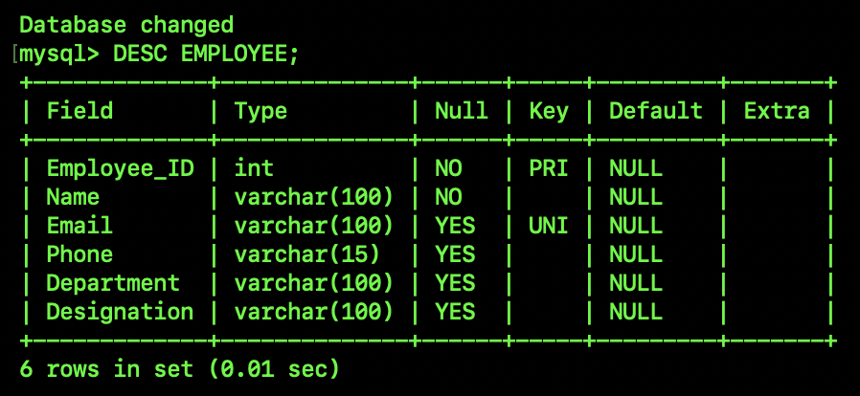
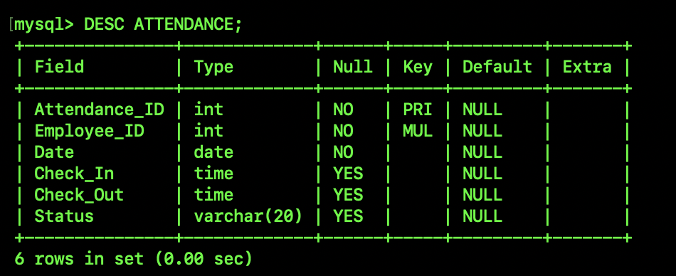
Relational Schema

Slide 10
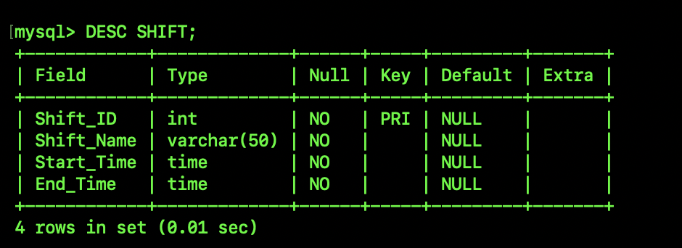
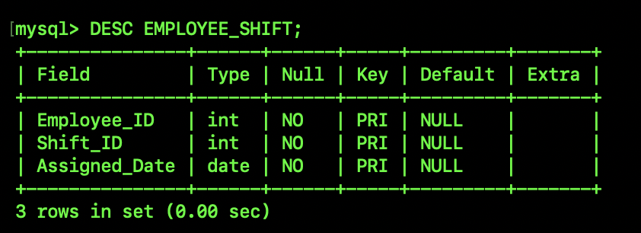
Relational Schema

Slide 11
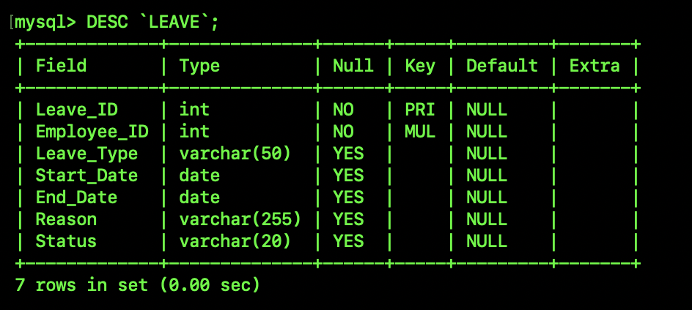
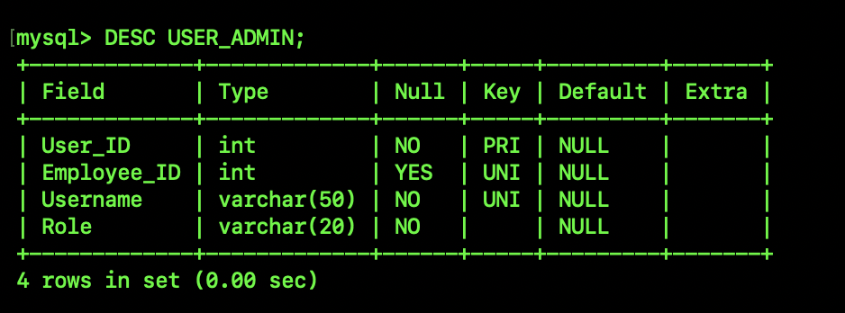
Relational Schema

Slide 12
Conclusion
A centralized relational database can unify employee attendance, shift and leave management.
The proposed ER model provides a structured foundation for implementation.
The system can be extended into a complete enterprise workforce management solution.
12 / 12

Slide 13
Thank You
07 / 07

